Slide 1
Introduction to
CEDAW Convention

Slide 2
I. Treaty body system
II. CEDAW session
1. Basic principles
2. Specific undertakings
3. Reporting process

Slide 3
Treaty body system
What is a treaty:
A ‘treaty’, ‘convention’ or a ‘covenant’ is an international legal instrument. A treaty imposes binding legal obligations upon a State who is a party to that treaty.
A State can become party to a treaty by ratifying it, which means that the State voluntarily decides to be bound by the provisions of the relevant treaty.
When a State becomes party to a treaty, it is obligated under international law to uphold and implement the provisions of the relevant treaty.

Slide 4
Treaty Body system
Who are parties to Treaties?
ONLY States:
States enter into treaties, and therefore accept obligations under the treaties
Citizens, individuals, NGOs are NOT parties
They do not have a formal role in the treaty system unless invited to participate by States
For implementation purposes, “States” means all constituent units
of the state (executive, legislative, judicial)
Treaties can also hold private actors accountable through States

Slide 5
Treaty body system
Treaty Bodies and the reporting process:
The treaty bodies were created in order to monitor and encourage States to uphold and implement their international obligations under the above-mentioned international human rights treaties.
The treaty bodies are international committees of independent experts who monitor State parties’ implementation of each of the eight core human rights treaties and their optional protocols.
The implementation of each of the international treaties is monitored by its own committee based on reports from State parties and information from non-governmental organisations (NGOs) and other relevant sources.

Slide 6
Convention on the Elimination of All Forms of Discrimination against Women (CEDAW)
Came into force in 1981
First international treaty to systematically and substantively address the needs of women
States are responsible for a range of steps toward the practical realisation of rights:
individual violations and weaknesses in the systems and institutions
address stereotypes and discriminatory social and cultural norms
private and public spheres
Strong international mandate – 184 ratifications
Sets the stage for national level work

Slide 7
Structure of the Convention
Articles 1-5: General Substantive
Framework of the Convention
Articles 6-16:
Specific Substantive Areas -
Articles 17-23:
Committee and Procedures
Articles 23-30:
Administration, Interpretation

Slide 8
CEDAW’s Basic Principles
Substantive Equality
Non-discrimination
State Obligation

Slide 9
Equality
1. Formal equality
Does not recognize difference; treats men and women as the same
Uses male standard, and puts burden on women to measure male standard
2. Protectionist equality
Recognizes difference; considers women’s weakness as the rationale for different treatment
Women lose opportunities to obtain a varied range of opportunities due to exclusion
3. Substantive equality
Recognizes difference and affirms equality between men and women
Places an obligation to correct the environment that disadvantages women
Equality of Opportunity; Equality of Access; Equality of results

Slide 10
Non-Discrimination
Article 1
For the purpose of the present Convention, the term “discrimination against women” shall mean any distinction, exclusion or restriction made on the basis of sex which has the effect or purpose of impairing or nullifying the recognition, enjoyment or exercise by women, irrespective of their marital status on a basis of equality of men and women, of human rights and fundamental freedoms in the political, economic, social, cultural, civil or any other field.

Slide 11
State Obligation
The framework to hold States accountable:
Legally binding obligations
Internal law is not an excuse for non-compliance
State Party comprises ALL constituent units
By ratifying a treaty, a State offers itself for scrutiny on the basis of standards set forth in the Convention
Articles 2-5 of CEDAW: General Undertakings; Articles 6-16 of CEDAW: Specific Undertakings

Slide 12
General Substantive Framework
Art. 1: Definition of Discrimination
Art. 2: Measures to be Taken to Eliminate Discrimination
Art. 3: Guarantees full development and advancement of women
Art. 4 Special Measures
Art. 5 Modifying Social and Cultural Patterns of Conduct

Slide 13
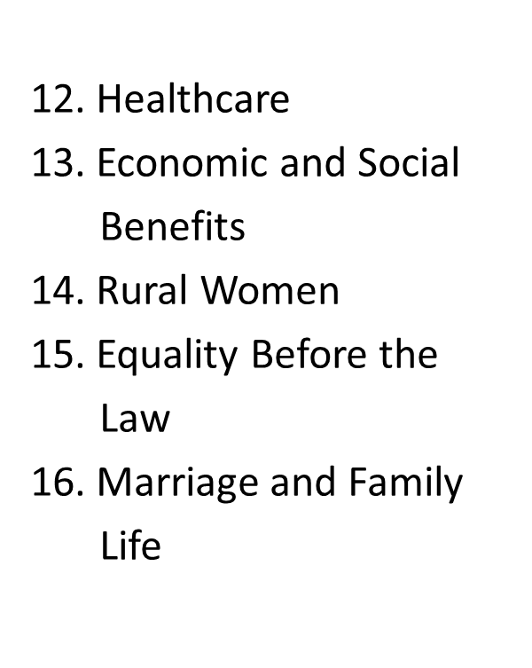
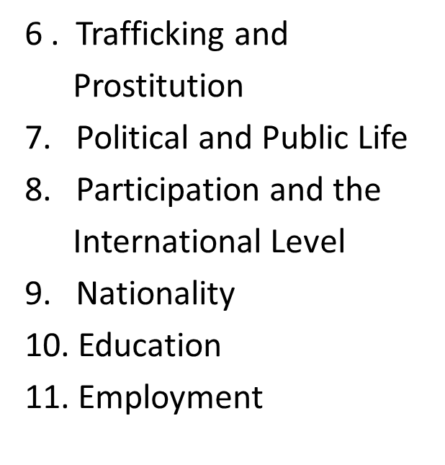
Specific Undertakings

Slide 14
CEDAW, article 16
1. States Parties shall take all appropriate measures to eliminate discrimination against women in all matters relating to marriage and family relations and in particular shall ensure, on a basis of equality of men and women:
(a) The same right to enter into marriage;
(b) The same right freely to choose a spouse and to enter into marriage only with their free and full consent;
(c) The same rights and responsibilities during marriage and at its dissolution;
(d) The same rights and responsibilities as parents, irrespective of their marital status, in matters relating to their children; in all cases the interests of the children shall be paramount;
(e) The same rights to decide freely and responsibly on the number and spacing of their children and to have access to the information, education and means to enable them to exercise these rights;
(f) The same rights and responsibilities with regard to guardianship, wardship, trusteeship and adoption of children, or similar institutions where these concepts exist in national legislation; in all cases the interests of the children shall be paramount;
(g) The same personal rights as husband and wife, including the right to choose a family name, a profession and an occupation;
(h) The same rights for both spouses in respect of the ownership, acquisition management, administration, enjoyment and disposition of property, whether free of charge or for a valuable consideration.
2. The betrothal and the marriage of a child shall have no legal effect, and all necessary action, including legislation, shall be taken to specify a minimum age for marriage and to make the registration of marriages in an official registry compulsory.

Slide 15
Steps of the reporting process
Ratification of Convention
Submission of Government report
One year after ratification; every four years thereafter
Get assigned a session; country rapporteur
Civil society opportunity to prepare shadow/alternative report
Pre-session working groups
Creation of list of issues and questions
Civil society opportunity to submit (suggested) list of issues and questions
Response to list of issues and questions
Notes:
SP report: reporting guidelines…
civil society: also exists shadow report guidelines..

Slide 16
Steps (cont’d)
Constructive dialogue
Two three hour sessions; divided by cluster of articles
Civil society/NHRIs opportunity present oral statement
NGO oral statement….
Concluding observations
Follow up procedure
criteria : ‘the fact that their lack of implementation would constitute a major obstacle for the implementation of the Convention as a whole and that they should be achievable within the set timeframe of one or two years.’
* Exceptional Reports
Notes:
- Constructive dialogue qts clusters: part I: articles 1 to 6; part II: articles 7 to 9; part III: articles 10 to 14; and part IV:

Slide 17
